Slide 1
Innate Immunity
Department of Biochemistry and Biotechnology
Alex Kwarteng (PhD)

Slide 2
Pattern Recognition
Pattern Recognition Receptors (PRR)
Toll-like receptors (TLRs)
NOD-like receptors (NLRs)
Pathogen Associated Molecular Patterns
(PAMPs)
Death Associated Molecular Patterns
(DAMPs)
Department of Biochemistry and Biotechnology
Innate Immunity-Antigen Processing and Presentation

Slide 3
Pattern Recognition
Pattern Recognition Receptors (PRR)
Toll-like receptors (TLRs)
NOD-like receptors (NLRs)
Pathogen Associated Molecular Patterns
(PAMPs)
Death Associated Molecular Patterns
(DAMPs)
Department of Biochemistry and Biotechnology
Innate Immunity-Antigen Processing and Presentation

Slide 4
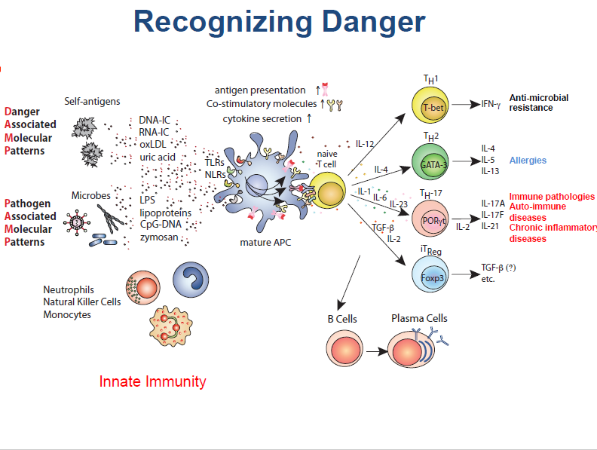
Department of Biochemistry and Biotechnology
Innate Immunity-Antigen Processing and Presentation

Slide 5
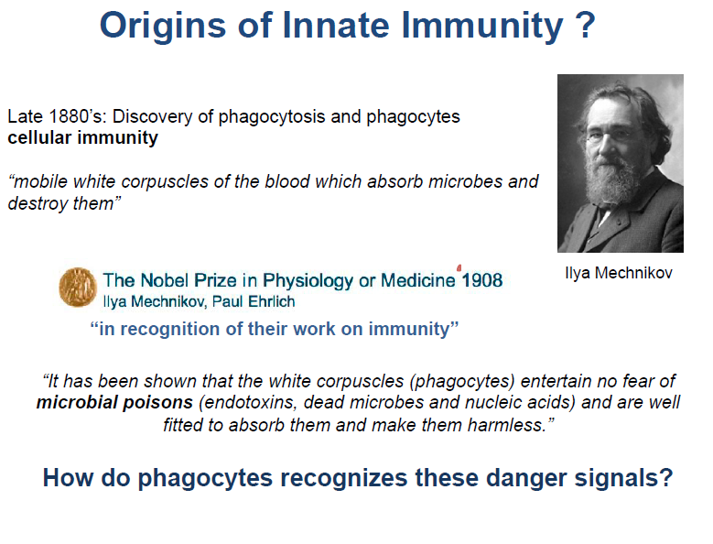
Department of Biochemistry and Biotechnology
Innate Immunity-Antigen Processing and Presentation

Slide 6
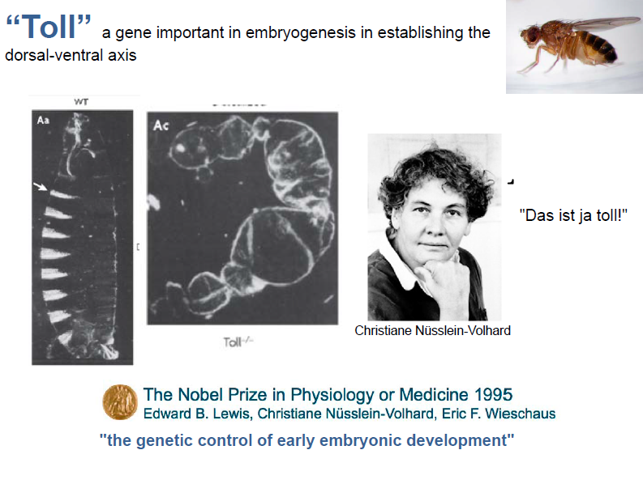
Department of Biochemistry and Biotechnology
Innate Immunity-Antigen Processing and Presentation

Slide 7
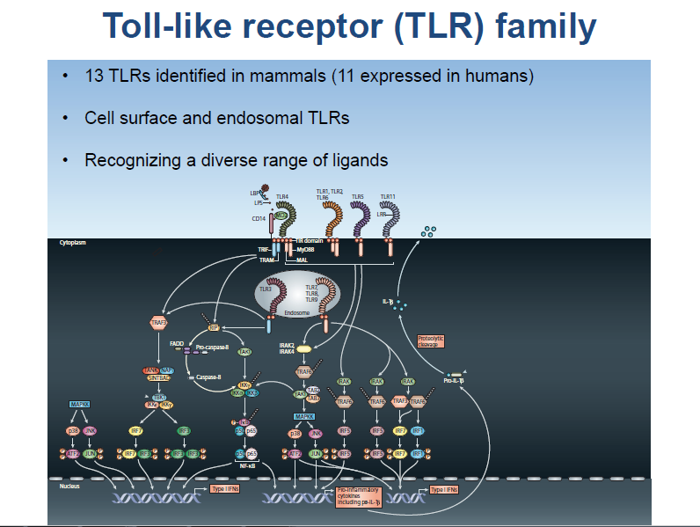
Department of Biochemistry and Biotechnology
Innate Immunity-Antigen Processing and Presentation

Slide 8
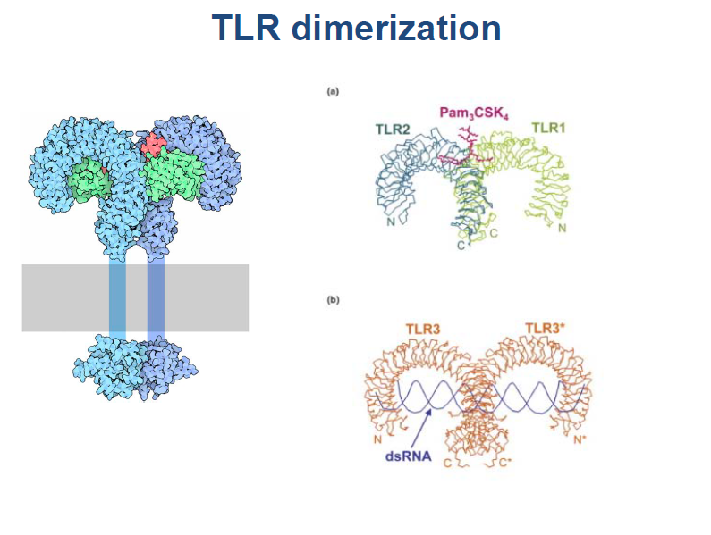
Department of Biochemistry and Biotechnology
Innate Immunity-Antigen Processing and Presentation

Slide 9
Antigen & Immunogen
An antigen is any agent capable of binding specifically to components of the immune system, such as the B cell receptor (BCR) on B lymphocytes and soluble antibodies.
An immunogen is any agent capable of inducing an immune response and is therefore immunogenic.
Department of Biochemistry and Biotechnology
Innate Immunity-Antigen Processing and Presentation

Slide 10
There are many compounds that are incapable of inducing an immune response, yet they are capable of binding with components of the immune system that have been induced specifically against them.
Thus all immunogens are antigens, but not all antigens are immunogens.
Department of Biochemistry and Biotechnology
Innate Immunity-Antigen Processing and Presentation

Slide 11
Antigens
Most are proteins or large polysaccharides from a foreign organism.
Microbes: Capsules, cell walls, toxins, viral capsids, flagella, etc.
Non-microbes: Pollen, egg white , red blood cell surface molecules, serum proteins, and surface molecules from transplanted tissue.
Department of Biochemistry and Biotechnology
Innate Immunity-Antigen Processing and Presentation

Slide 12
Lipids and nucleic acids are only antigenic when combined with proteins or polysaccharides.
Department of Biochemistry and Biotechnology
Innate Immunity-Antigen Processing and Presentation

Slide 13
Haptens
A hapten is a compound that, by itself, is incapable of inducing an immune response (non-immunogenic) but against which an immune response can be induced when conjugated to a carrier.
Department of Biochemistry and Biotechnology
Innate Immunity-Antigen Processing and Presentation

Slide 14
Requirements for immunogenicity
Foreignness
High molecular size
Complexity of structure
Degradability
Antigenic determinants
Others, conformation, charge, dosage, route
Department of Biochemistry and Biotechnology
Innate Immunity-Antigen Processing and Presentation

Slide 15
Epitope
Small part of an antigen that interacts with an antibody.
Any given antigen may have several epitopes.
May be Linear or Conformational
Each epitope is recognized by a different antibody.
Department of Biochemistry and Biotechnology
Innate Immunity-Antigen Processing and Presentation

Slide 16
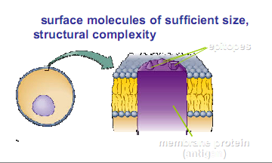
Antigens/Epitopes
epitopes
membrane protein
Department of Biochemistry and Biotechnology
Innate Immunity-Antigen Processing and Presentation

Slide 17
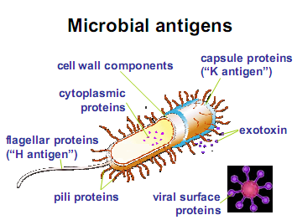
Microbial antigens/epitopes
Department of Biochemistry and Biotechnology
Innate Immunity-Antigen Processing and Presentation

Slide 18
Antibodies
Made in response to exposure to the antigen, and react specifically to that antigen
Proteins that recognize and bind to a particular antigen with very high specificity.
One virus or microbe may have several antigenic determinant sites, to which different antibodies may bind.
Each antibody has at least two identical sites that bind antigen: Antigen binding sites.
Department of Biochemistry and Biotechnology
Innate Immunity-Antigen Processing and Presentation

Slide 19
Antibodies
Valence of an antibody: Number of antigen binding sites. Most are bivalent.
Belong to a group of serum proteins called immunoglobulins (Igs).
Antigen-antibody reactions
Antiserum: serum that contains a large amount of antibodies that bind to a particular antigen
Natural antibodies
Igs which react specifically to antigens of no known exposure.
Usually of low titre but may confer resistance to certain infections.
Department of Biochemistry and Biotechnology
Innate Immunity-Antigen Processing and Presentation

Slide 20
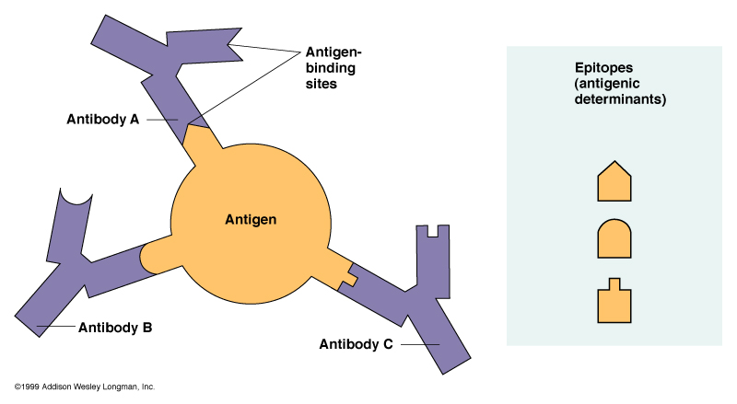
Epitopes: Antigen Regions that Interact with Antibodies
Department of Biochemistry and Biotechnology
Innate Immunity-Antigen Processing and Presentation

Slide 21
Valence of an antibody: Number of antigen binding sites. Most are bivalent.
Belong to a group of serum proteins called immunoglobulins (Igs) Antibodies work in three ways:
Neutralisation. blocking the biological activity of their target molecule e.g a toxin, by binding to it's receptor
Opsonisation. interact with special receptors on various cells, including macrophages, neutrophils, basophils and mast cells allowing them to "recognise" and respond to the antigen
Complement Activation. cause direct lysis by complement complement recruitment also enhances phagocytosis
Antigen-antibody reactions
Antiserum: serum that contains a large amount of antibodies that bind to a particular antigen
Natural antibodies
Igs which react specifically to antigens of no known exposure.
Usually of low titre but may confer resistance to certain infections.
Department of Biochemistry and Biotechnology
Innate Immunity-Antigen Processing and Presentation

Slide 22
Antibodies work in three ways:
Neutralisation. blocking the biological activity of their target molecule e.g a toxin, by binding to it's receptor
Opsonisation. interact with special receptors on various cells, including macrophages, neutrophils, basophils and mast cells allowing them to "recognise" and respond to the antigen
Complement Activation. cause direct lysis by complement complement recruitment also enhances phagocytosis
Department of Biochemistry and Biotechnology
Innate Immunity-Antigen Processing and Presentation

Slide 23
4. Neutralization: IgG inactivates viruses by binding to their surface and neutralize toxins by blocking their active sites.
5. Antibody-dependent-cell-mediated cytotoxicity: Used to destroy large organisms (e.g.: worms). Target organism is coated with antibodies and bombarded with chemicals from nonspecific immune cells.
6. Complement Activation: Both IgG and IgM trigger the complement system which results in cell lysis and inflammation.
Department of Biochemistry and Biotechnology
Innate Immunity-Antigen Processing and Presentation

Slide 24
All the interactions between antigen and antibody are non-covalent interactions:
ionic interactions, eg. like attraction of opposite charges on amino acids;
hydrogen bonds;
hydrophobic interactions.
Department of Biochemistry and Biotechnology
Innate Immunity-Antigen Processing and Presentation

Slide 25
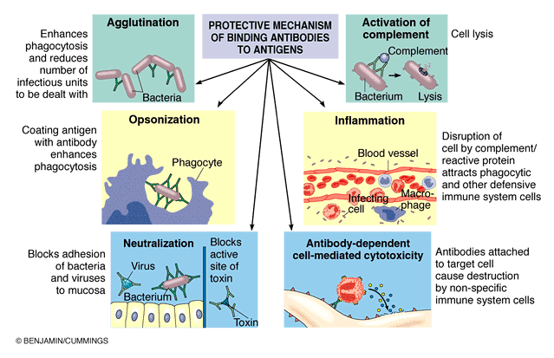
Protective Mechanisms of Antigen-Antibody Binding
Department of Biochemistry and Biotechnology
Innate Immunity-Antigen Processing and Presentation

Slide 26
Types of antigens
Exogenous antigens (Mostly expressed by extracelluar pathogens ie. parasites)
Endogenous antigens (Expressed by intracellular pathogens, viruses & some bacteria)
T-dependent antigens
T- independent antigens
Department of Biochemistry and Biotechnology
Innate Immunity-Antigen Processing and Presentation

Slide 27
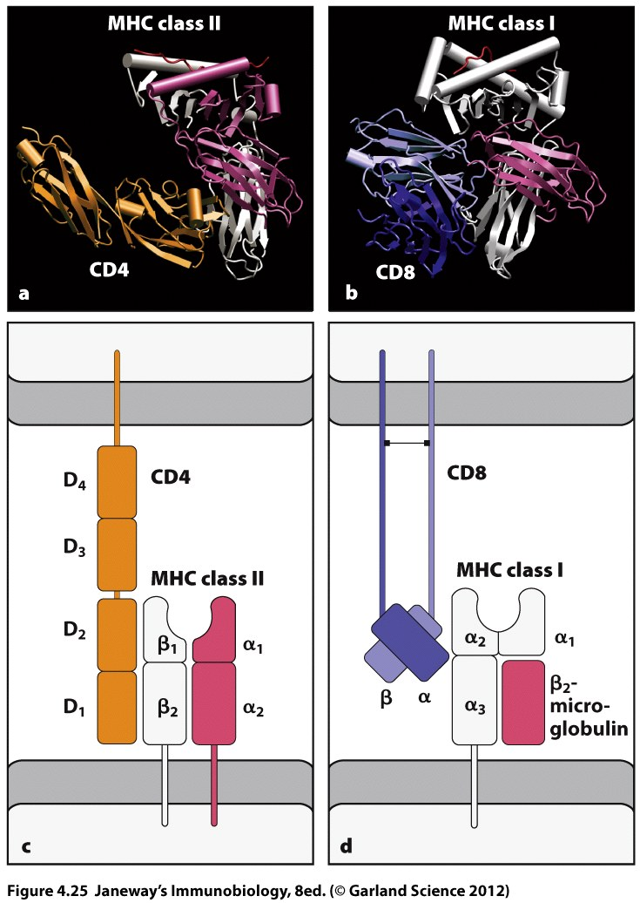
Department of Biochemistry and Biotechnology
Innate Immunity-Antigen Processing and Presentation

Slide 28
Antigen Processing and Presentation
Why is it needed? What is the purpose?
How does it happen? & What are the components
How are the pathways of endogenous and exogenous antigen kept apart?
What are the consequences?
(What happens after presentation & processing)
Department of Biochemistry and Biotechnology
Innate Immunity-Antigen Processing and Presentation

Slide 29
Antigen Presenting Cells
Dendritic cells
Monocytes/Macrophages
B-cells
Department of Biochemistry and Biotechnology
Innate Immunity-Antigen Processing and Presentation

Slide 30
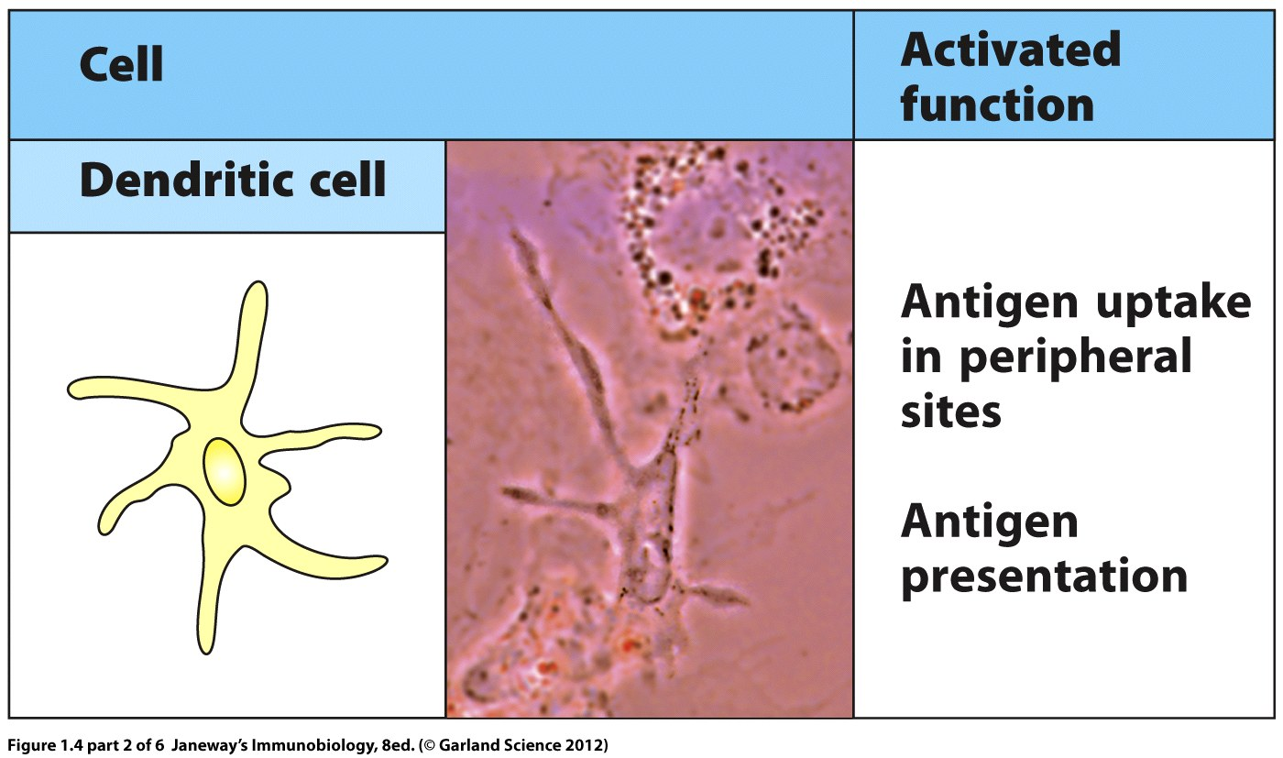
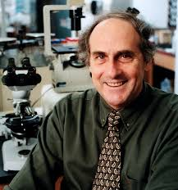
DCs were first characterized by Ralph Steinman. Dr. Steinman was awarded a share in the 2011 Nobel Prize in Physiology or Medicine for his seminal work.
Department of Biochemistry and Biotechnology
Innate Immunity-Antigen Processing and Presentation

Slide 31
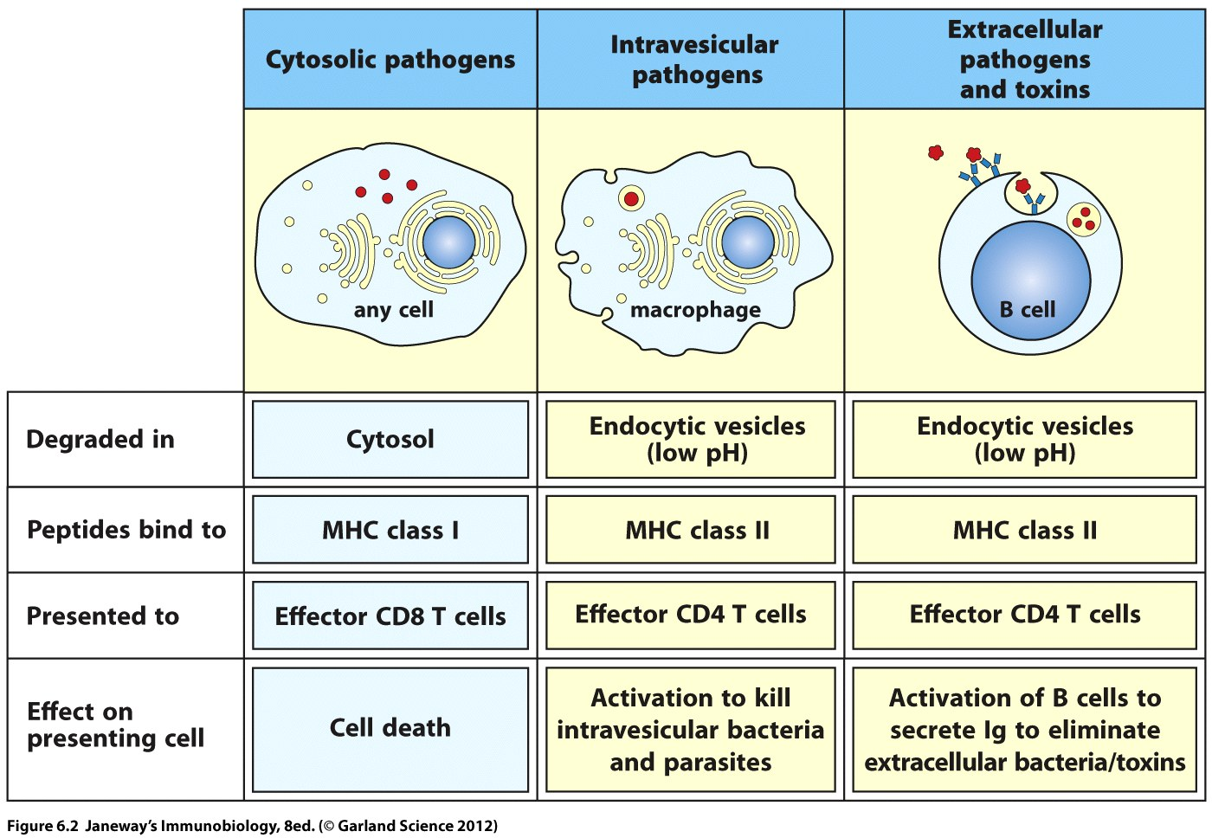
Department of Biochemistry and Biotechnology
Innate Immunity-Antigen Processing and Presentation

Slide 32
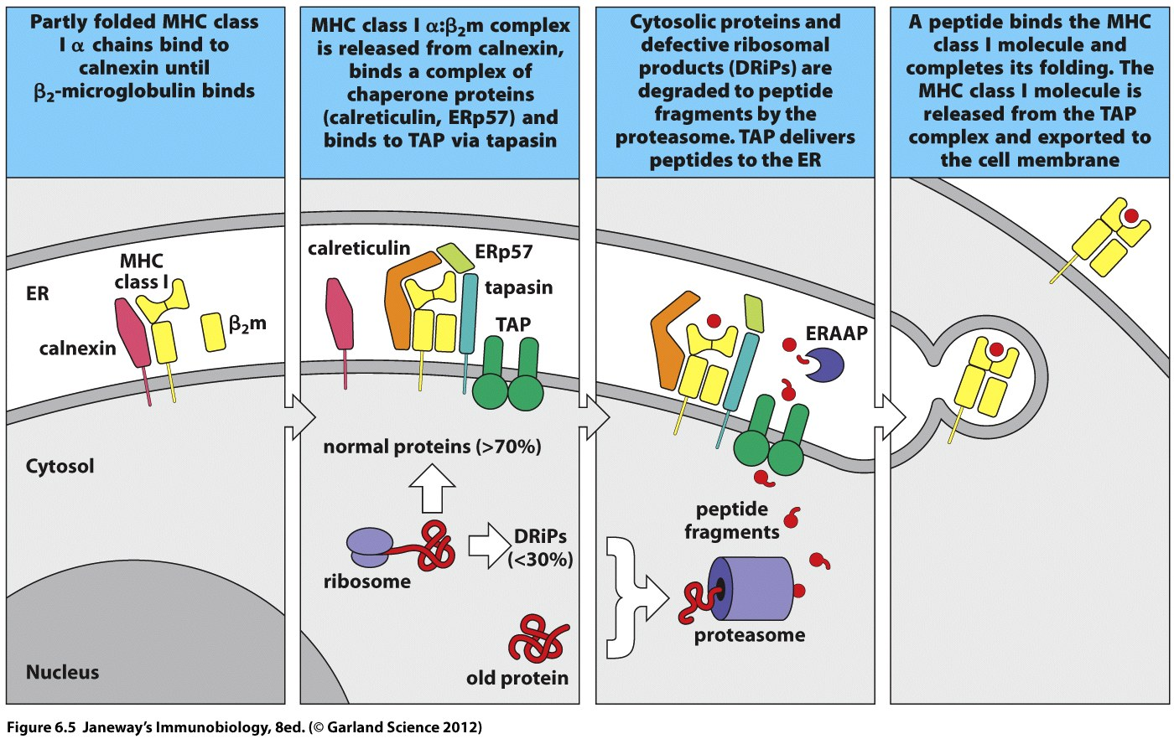
Department of Biochemistry and Biotechnology
Innate Immunity-Antigen Processing and Presentation

Slide 33
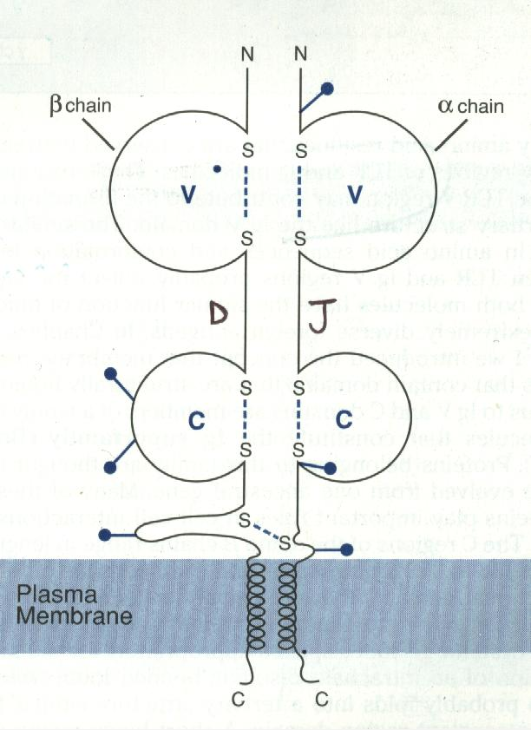
T cell receptor: antigen receptor of T cells
Cannot recognise antigen in solution
Must have the antigen processed
and presented to it
Specialised molecules present
antigens to T cells:
Antigen presentation cells (APC’s)
MHC molecules
Department of Biochemistry and Biotechnology
Innate Immunity-Antigen Processing and Presentation

Slide 34
T Cell Receptor
TCR
Antigen
MHC
Major Histocompatibility Complex
Department of Biochemistry and Biotechnology
Innate Immunity-Antigen Processing and Presentation

Slide 35
Antigen presentation by MHC molecules
Two types of MHC molecules
MHC class I
MHC class II
Two types of T cells
CD4 T helper cells
CD8 T cytotoxic cells
Two types of antigen
Endogenous (from within the cell)
Exogenous (from outside the cell)
Department of Biochemistry and Biotechnology
Innate Immunity-Antigen Processing and Presentation

Slide 36
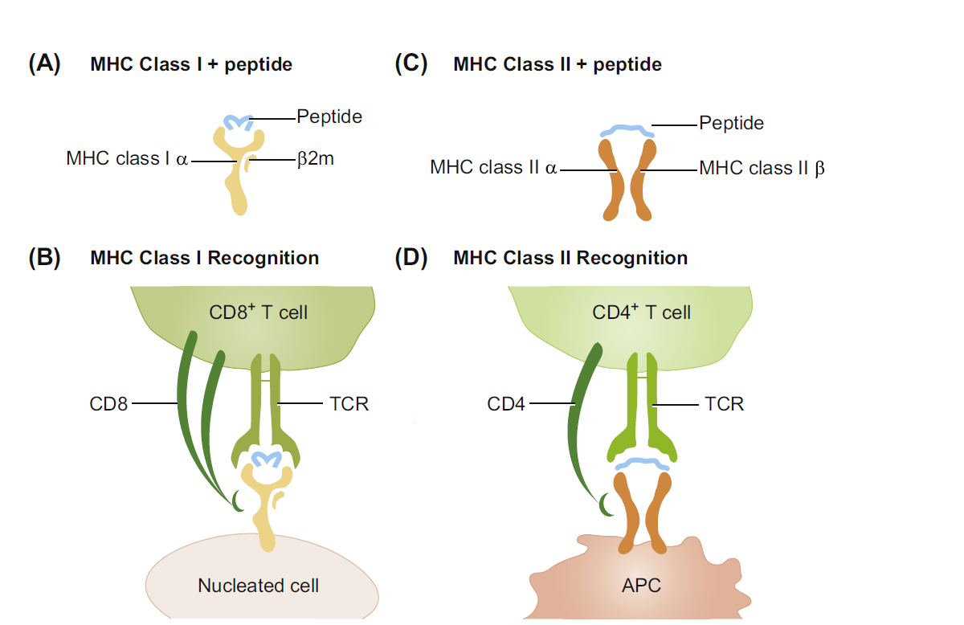
MHC Class I Pathway
MHC Class II Pathway
Department of Biochemistry and Biotechnology
Innate Immunity-Antigen Processing and Presentation

Slide 37
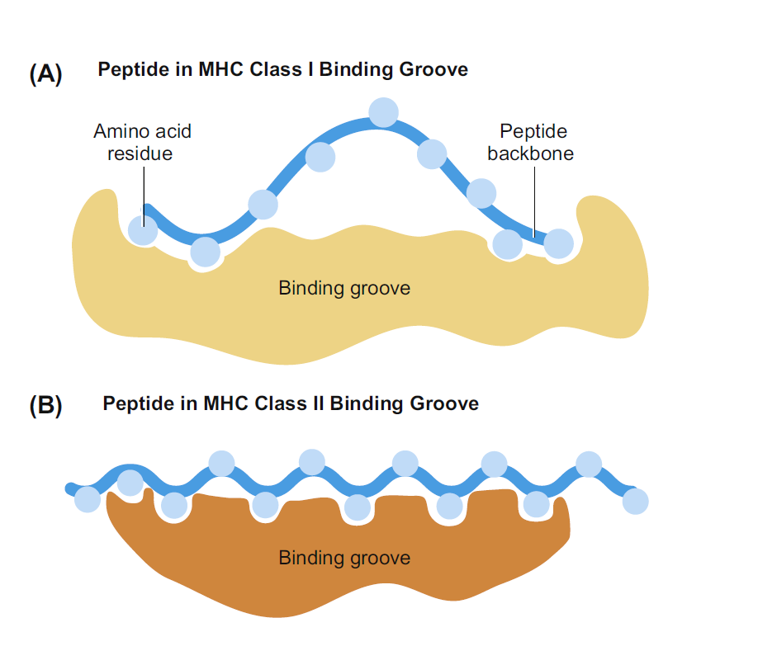
Peptide within groove
8-10 amino acids
15-20 amino acids
Peptides extends beyond groove
Department of Biochemistry and Biotechnology
Innate Immunity-Antigen Processing and Presentation

Slide 38
Type of T cell activated
MHC class I activate CD8+ T cytotoxic cells
Present endogenous (eg viral) antigens
Target cell is killed by CD8+ T cell
Any cell can become virally infected
Therefore: MHC class I is on all nucleated cells
Department of Biochemistry and Biotechnology
Innate Immunity-Antigen Processing and Presentation

Slide 39
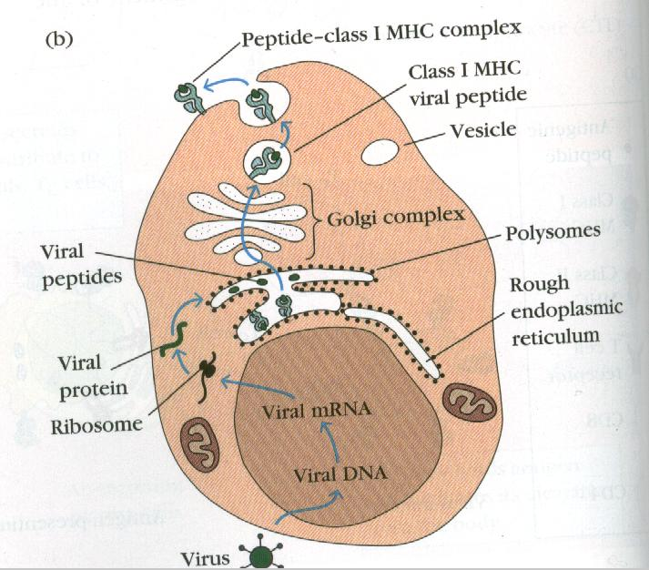
Endogenous antigen presentation
3
2
1
Department of Biochemistry and Biotechnology
Innate Immunity-Antigen Processing and Presentation

Slide 40
MHC class I Ag presentation to CD8 T cell
Ag
CD8+ T cell
Cell expressing MHC class I
CD 8 binds α3 domain
Stabilises interaction
Death of target
cell
Department of Biochemistry and Biotechnology
Innate Immunity-Antigen Processing and Presentation

Slide 41
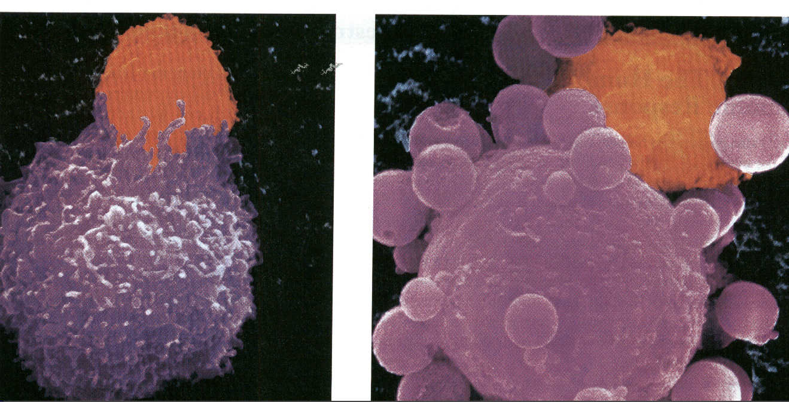
CD8 CTL
Tumour cell
Department of Biochemistry and Biotechnology
Innate Immunity-Antigen Processing and Presentation

Slide 42
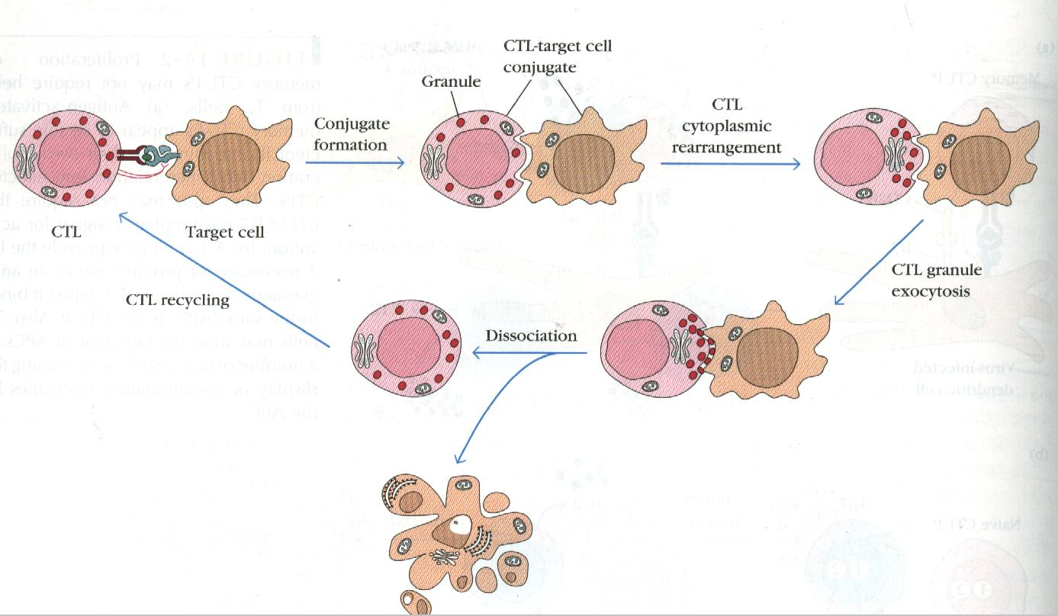
Department of Biochemistry and Biotechnology
Innate Immunity-Antigen Processing and Presentation

Slide 43
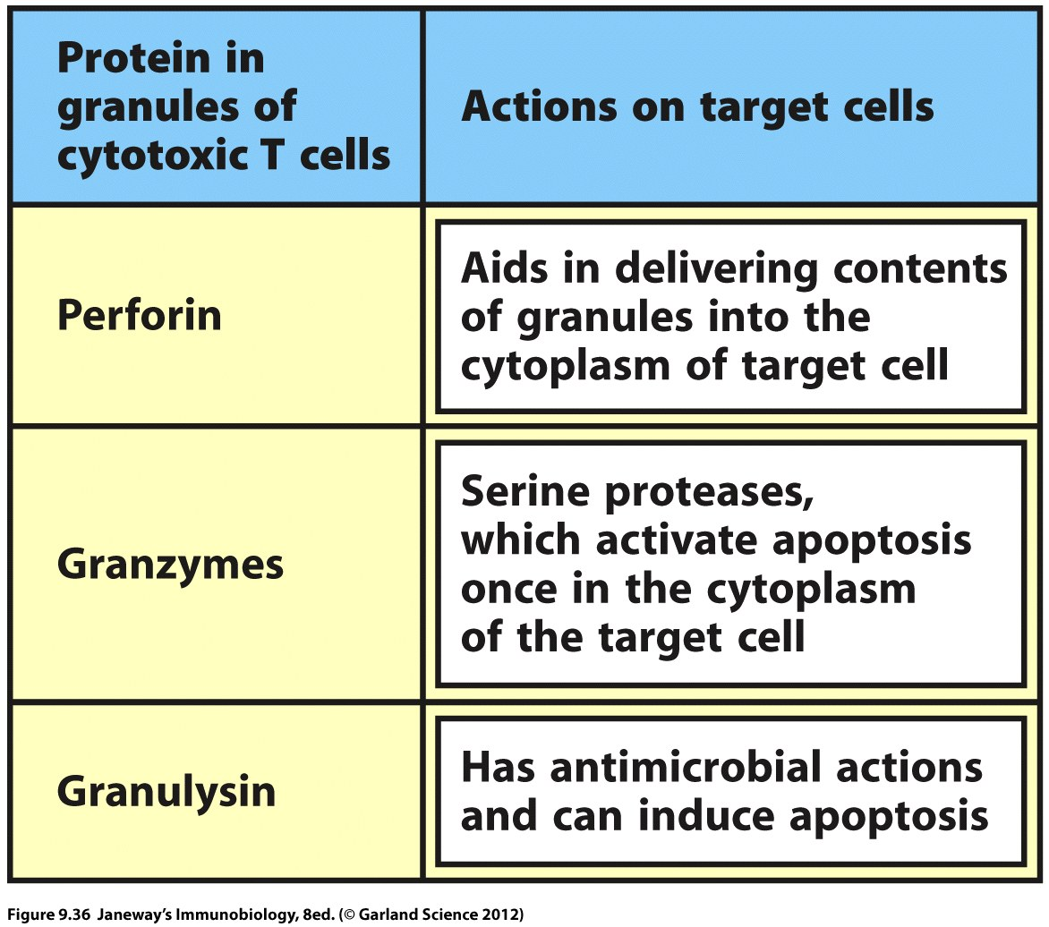
Some Effector Molecules of CTLs
Department of Biochemistry and Biotechnology
Innate Immunity-Antigen Processing and Presentation

Slide 44
Type of T cell activated
MHC class II activate CD4 T helper cells
Present exogenous (eg bacteria) antigens
CD4 T cells upregulate all immune functions
MHC class II found only on cells that sample the extracellular environment
Department of Biochemistry and Biotechnology
Innate Immunity-Antigen Processing and Presentation

Slide 45
Type of T cell activated
MHC class II activate CD4 T helper cells
Present exogenous (eg bacteria) antigens
CD4 T cells upregulate all immune functions
MHC class II found only on cells that sample the extracellular environment
Department of Biochemistry and Biotechnology
Innate Immunity-Antigen Processing and Presentation

Slide 46
MHC class II-CD4 T cell activation
CD4 T helper cells up regulate immune function
Stimulate Mφ activation and phagocytosis, B cell antibody production
Help to clear exogenous antigen (ie. parasites)
Department of Biochemistry and Biotechnology
Innate Immunity-Antigen Processing and Presentation

Slide 47
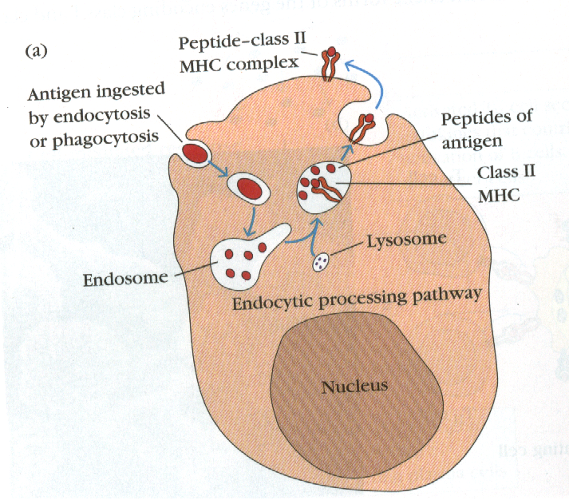
Exogenous antigen presentation
4
3
1
2
Department of Biochemistry and Biotechnology
Innate Immunity-Antigen Processing and Presentation

Slide 48
MHC class II Ag presentation to CD4 T cell
Cell expressing MHC class II
CD4+ T cell
CD 4 binds mainly β2 domain
Stabilises interaction
Upreglation of
Immune responses
Department of Biochemistry and Biotechnology
Innate Immunity-Antigen Processing and Presentation

Slide 49
A question of language
Cells that express MHC class I, present endogenous ag
Are killed by CD8+ cells
Are called Target cells
Cells that express MHC class II, present exogenous ag
Activate the CD4 T cell response
Are called Antigen presenting cells
Department of Biochemistry and Biotechnology
Innate Immunity-Antigen Processing and Presentation

Slide 50
Target cells:
All nucleated cells express MHC class I
Can be a target cell if virally infected
Antigen presenting cells
Limited number of cells express MHC class II
Must sample extracellular environment
Monocytes, MΦ, B cells
Department of Biochemistry and Biotechnology
Innate Immunity-Antigen Processing and Presentation

Slide 51
How does a cell present pathogens, such as viruses that have been engulfed from extracellular sources in ways that will activate the needed CTL responses?
Department of Biochemistry and Biotechnology
Innate Immunity-Antigen Processing and Presentation

Slide 52
Cross-presentation
The phenomenon of cross-presentation requires that internalized antigens that would normally be handled by the exogenous pathway leading to class II MHC presentation somehow become redirected to a class I peptide loading pathway.
Department of Biochemistry and Biotechnology
Innate Immunity-Antigen Processing and Presentation

Slide 53
Cross-presentation
The phenomenon of cross-presentation requires that internalized antigens that would normally be handled by the exogenous pathway leading to class II MHC presentation somehow become redirected to a class I peptide loading pathway.
Department of Biochemistry and Biotechnology
Innate Immunity-Antigen Processing and Presentation

Slide 54
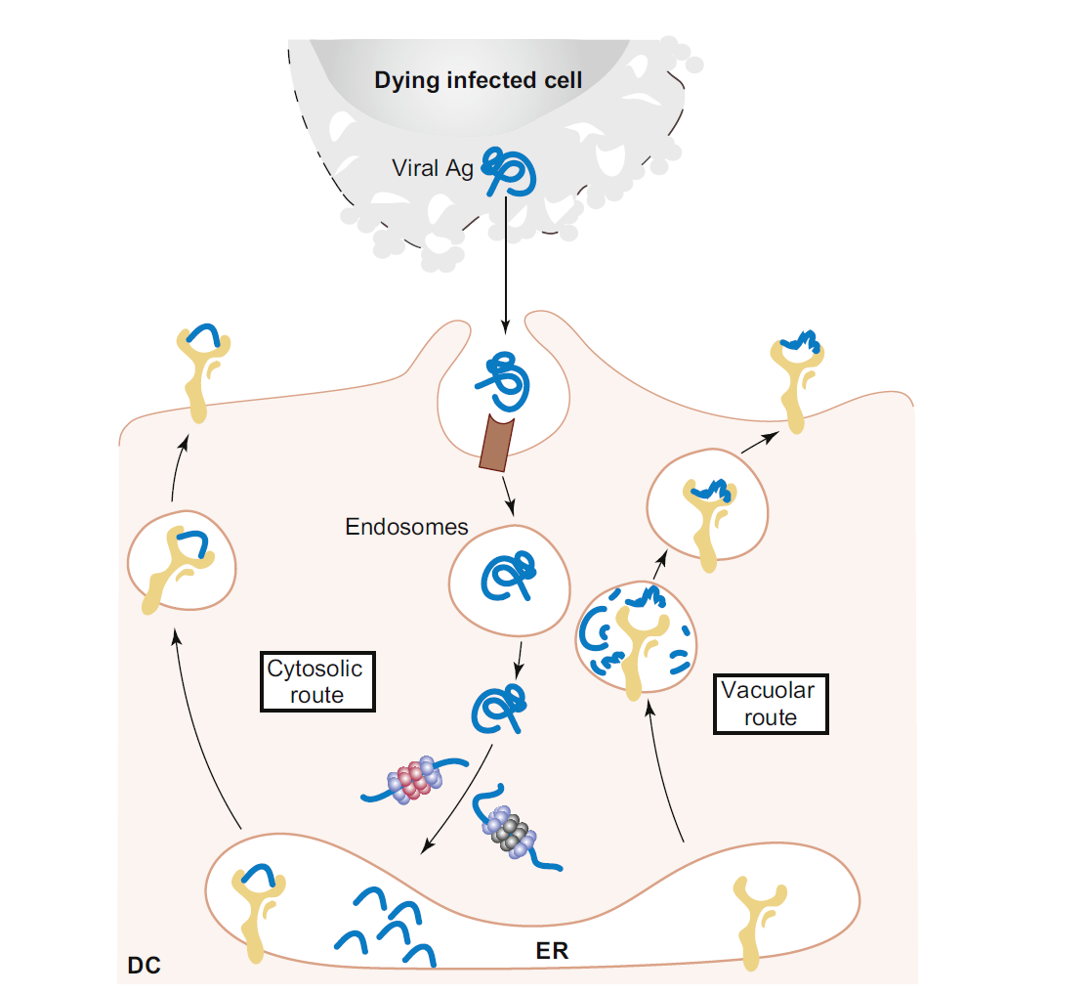
Cross Presentation
1. Cytosolic route
2. Vacuolar route
Department of Biochemistry and Biotechnology
Innate Immunity-Antigen Processing and Presentation

Slide 55
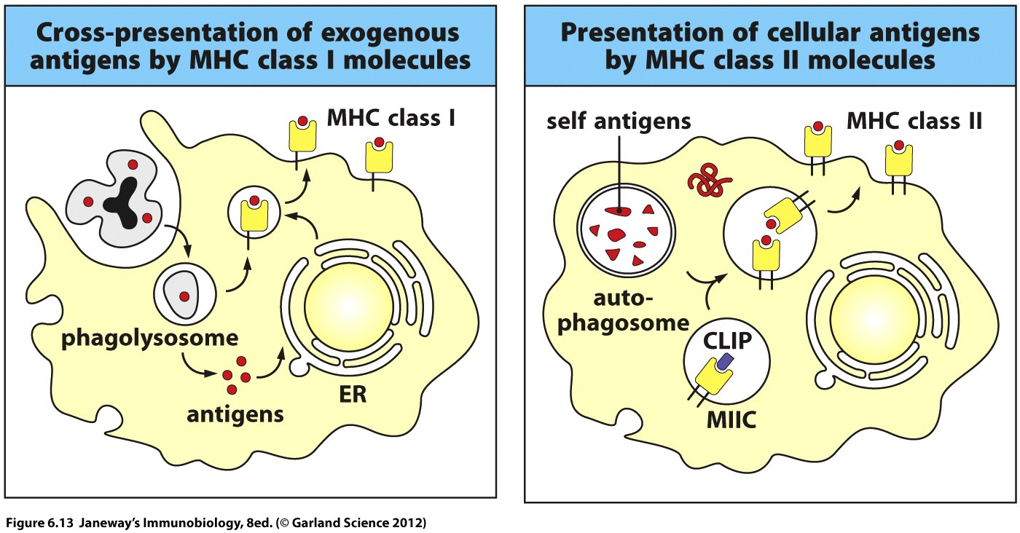
Department of Biochemistry and Biotechnology
Innate Immunity-Antigen Processing and Presentation

Slide 56
Cells involved in cross-presentation include
Dendritic and macrophages.
Read on DC licensing in the activation of CTLs
Read a review from Kurts et al 2010 Nature Immunology Review
Department of Biochemistry and Biotechnology
Innate Immunity-Antigen Processing and Presentation

Slide 57
Department of Biochemistry and Biotechnology
Innate Immunity-Antigen Processing and Presentation

Slide 58
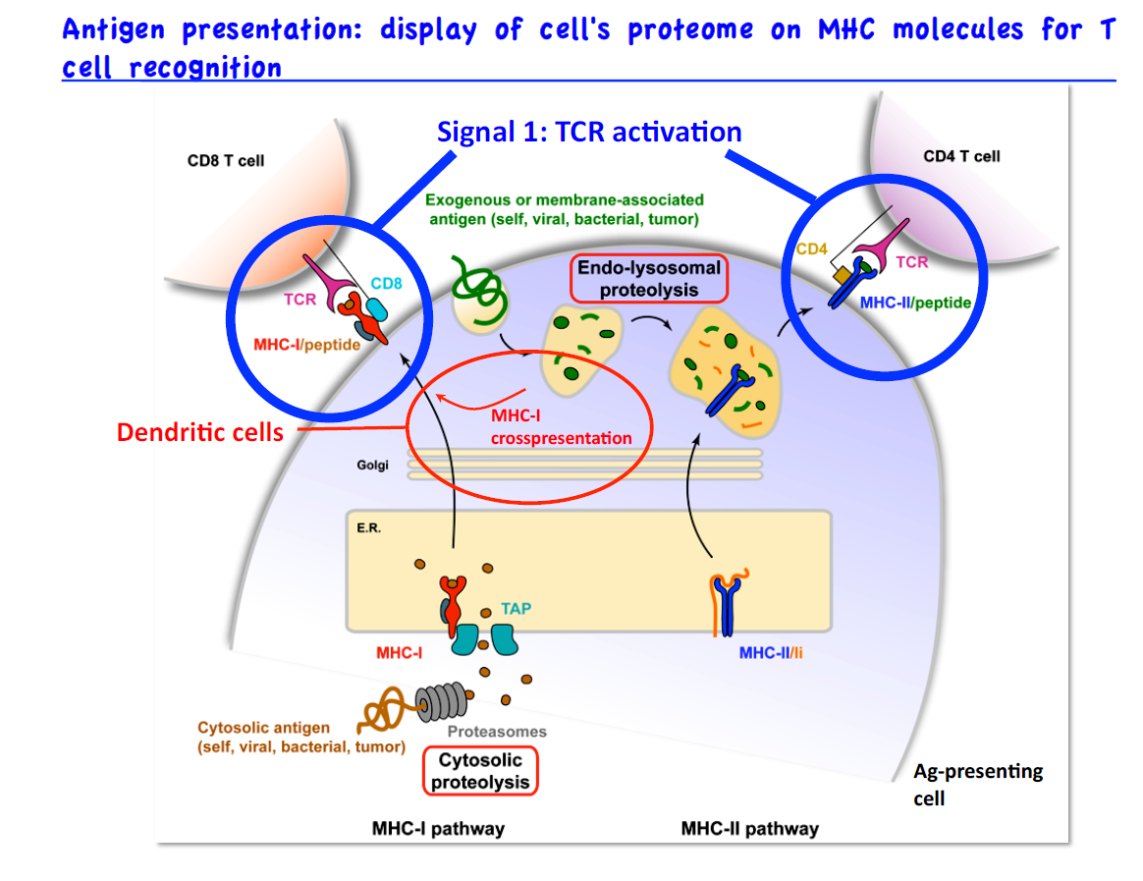
Department of Biochemistry and Biotechnology
Innate Immunity-Antigen Processing and Presentation

Slide 59
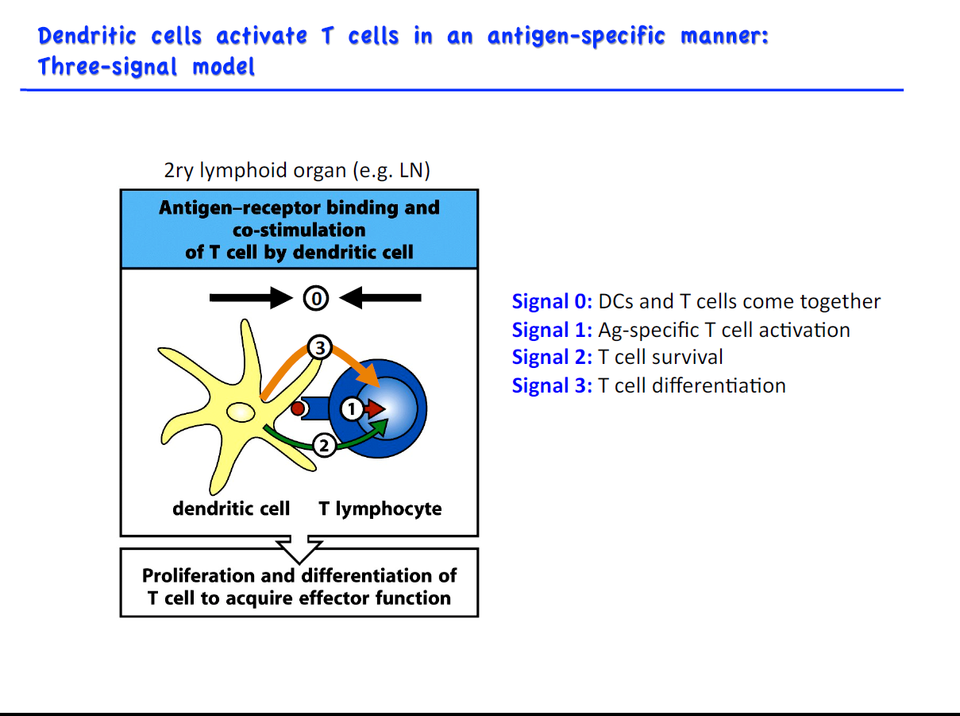
Department of Biochemistry and Biotechnology
Innate Immunity-Antigen Processing and Presentation

Slide 60
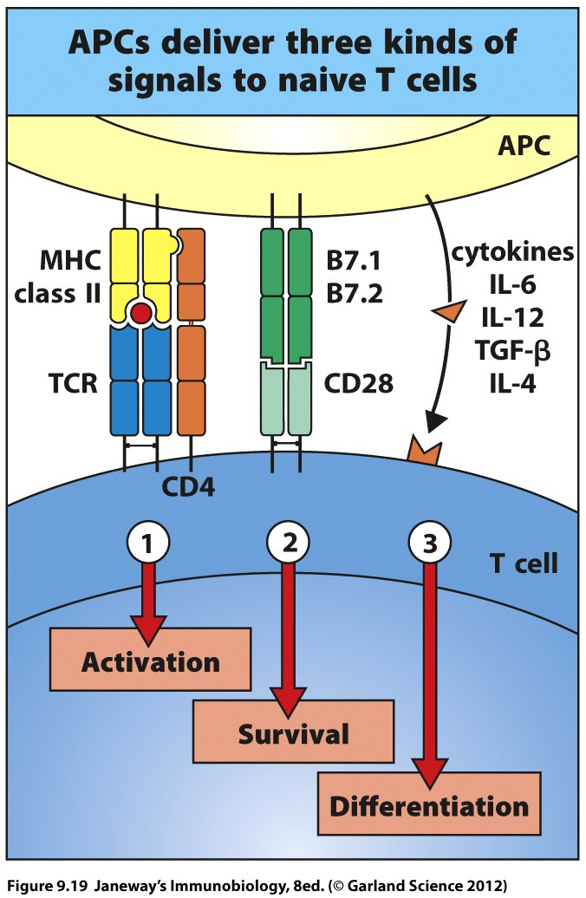
It takes 3 not 2!!!
Department of Biochemistry and Biotechnology
Innate Immunity-Antigen Processing and Presentation

Slide 61
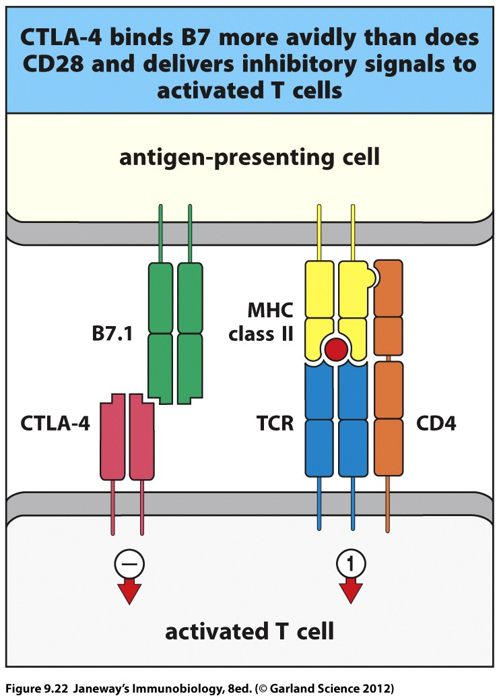
Applying The Brakes
Department of Biochemistry and Biotechnology
Innate Immunity-Antigen Processing and Presentation

Slide 62
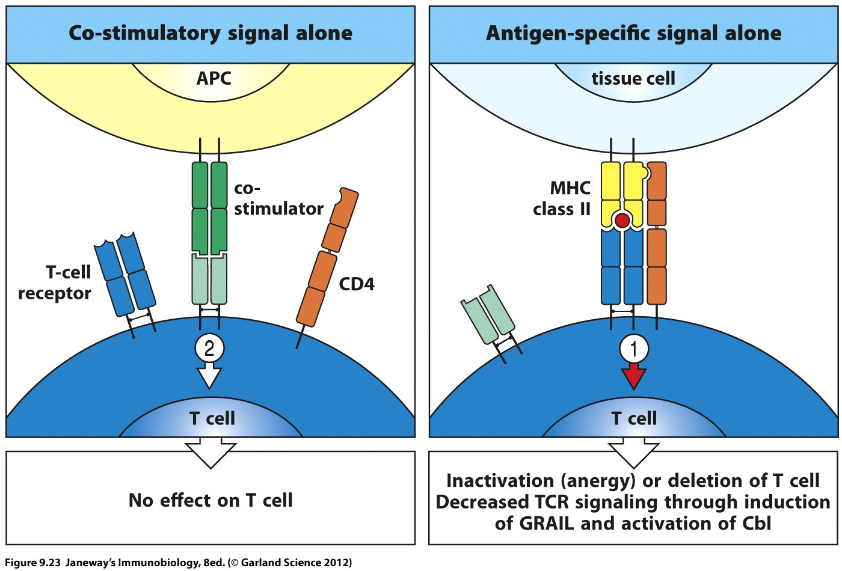
We never walk alone: LFC
Department of Biochemistry and Biotechnology
Innate Immunity-Antigen Processing and Presentation

Slide 63
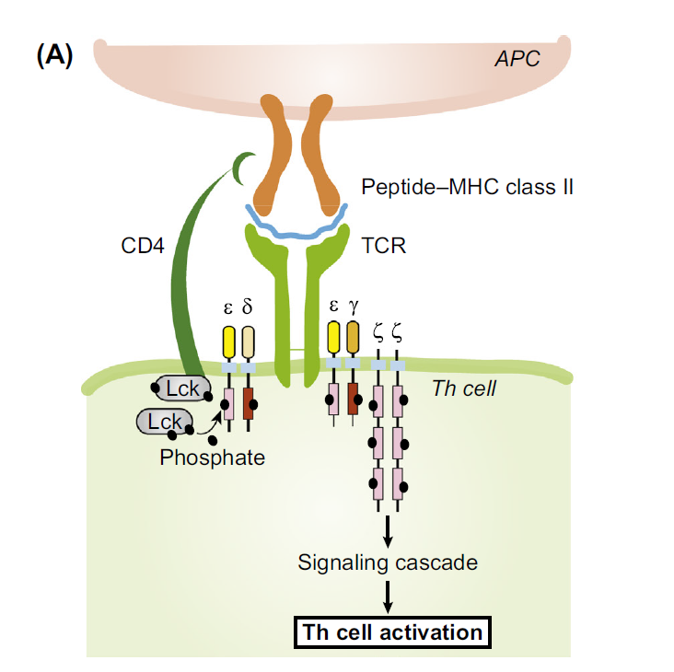
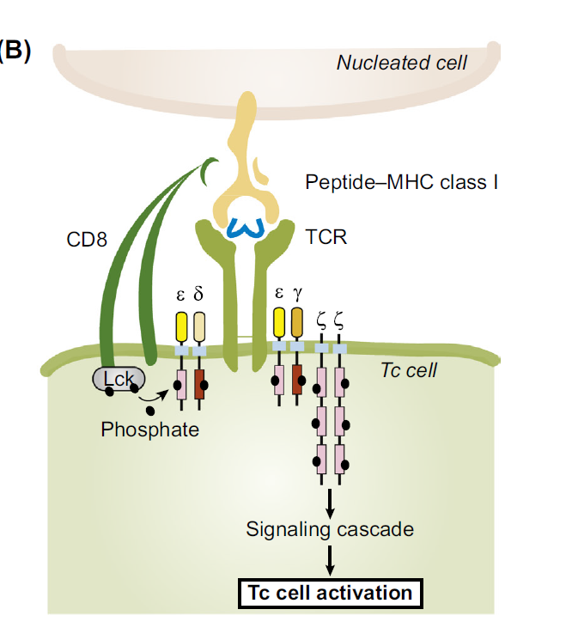
Role of coceptors in TCR signalling
Department of Biochemistry and Biotechnology
Innate Immunity-Antigen Processing and Presentation

Slide 64
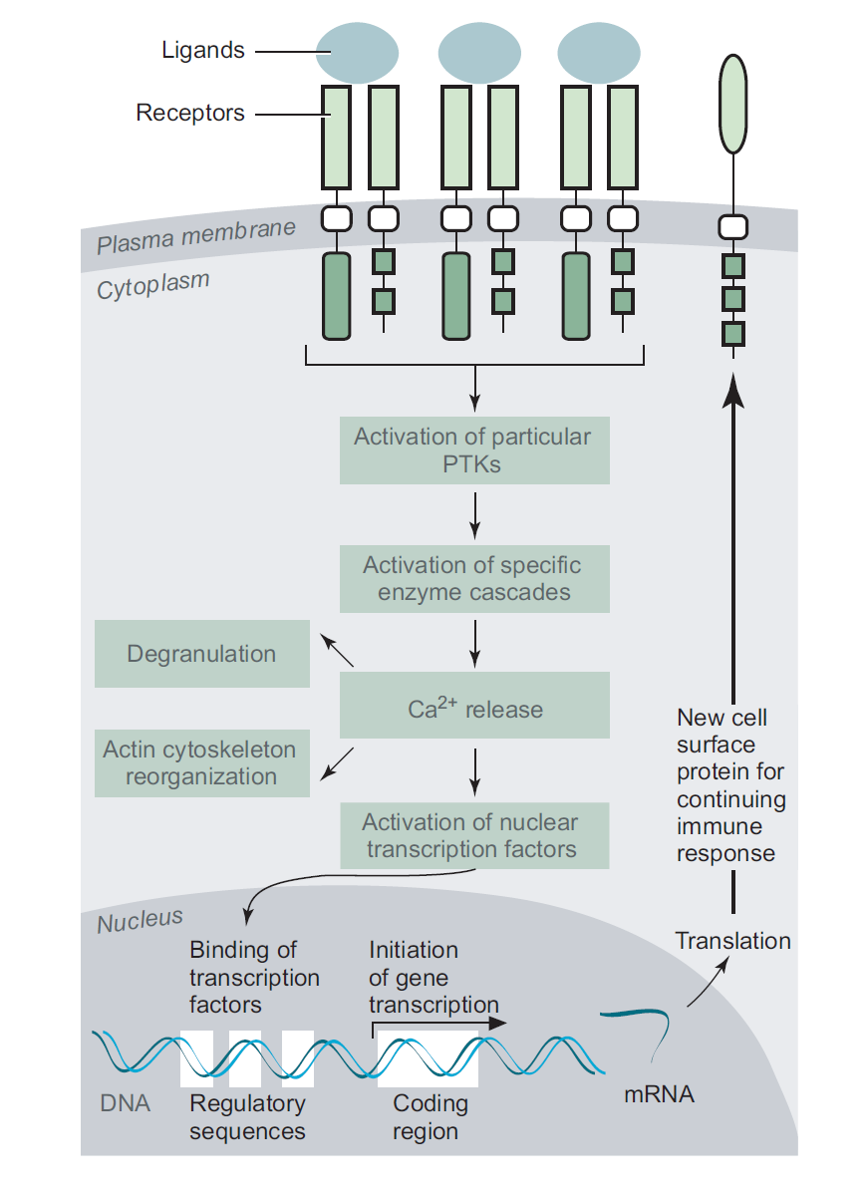
Intracellular signalling Pathway
Department of Biochemistry and Biotechnology
Innate Immunity-Antigen Processing and Presentation

Slide 65
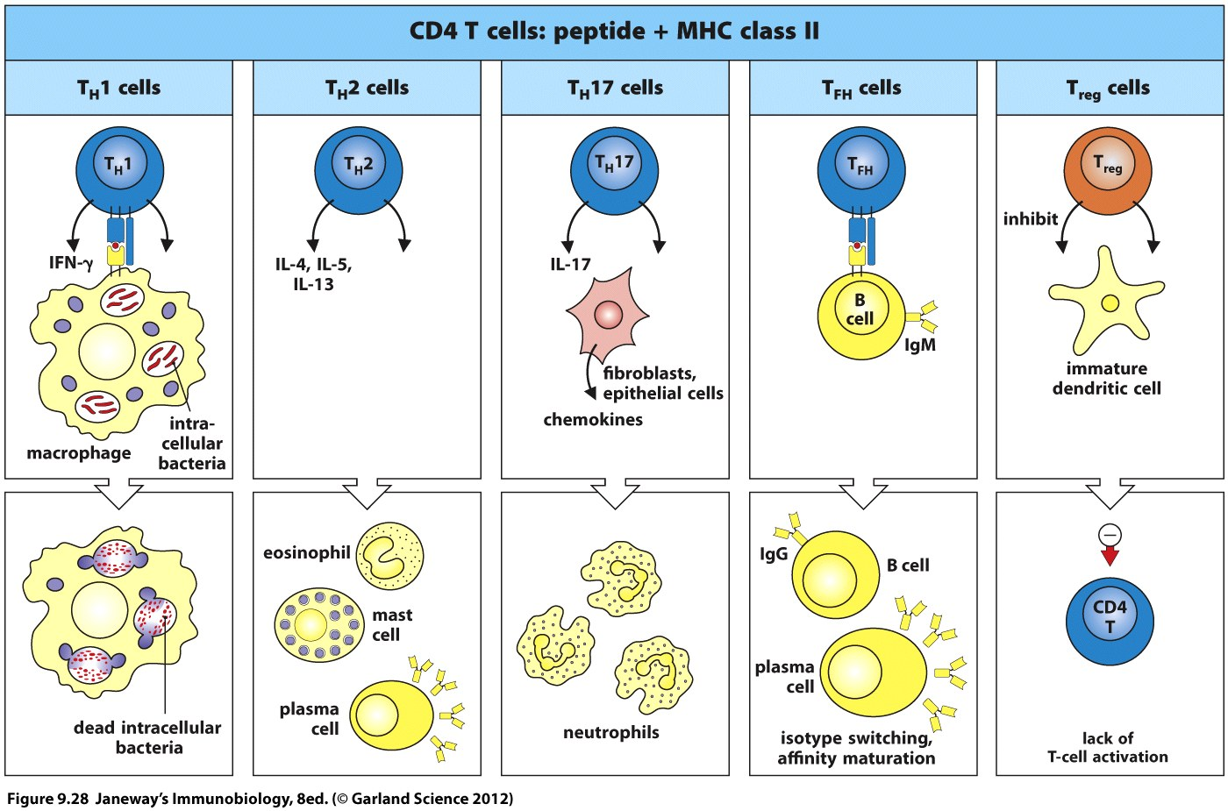
Functional Activities of CD4+ T cells
Department of Biochemistry and Biotechnology
Innate Immunity-Antigen Processing and Presentation

Slide 66
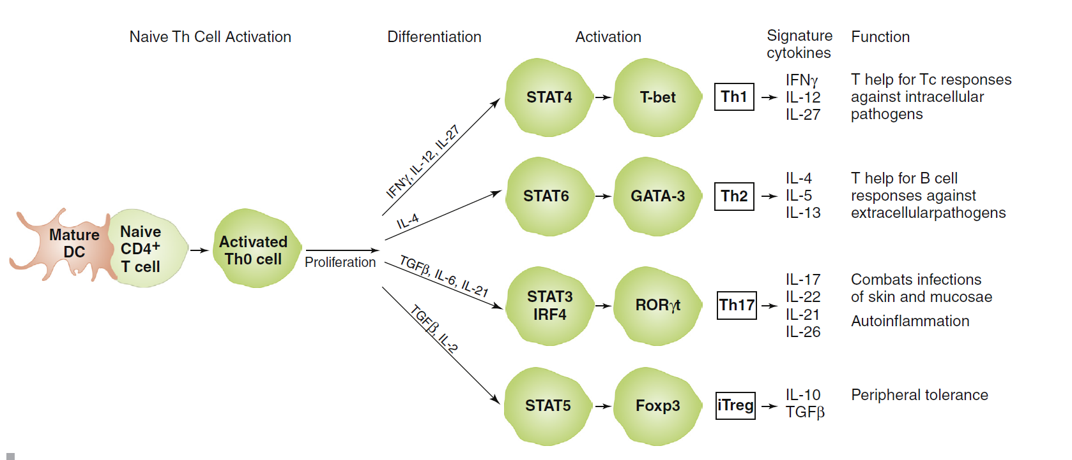
Effector T cell Differentiation
Department of Biochemistry and Biotechnology
Innate Immunity-Antigen Processing and Presentation

Slide 67
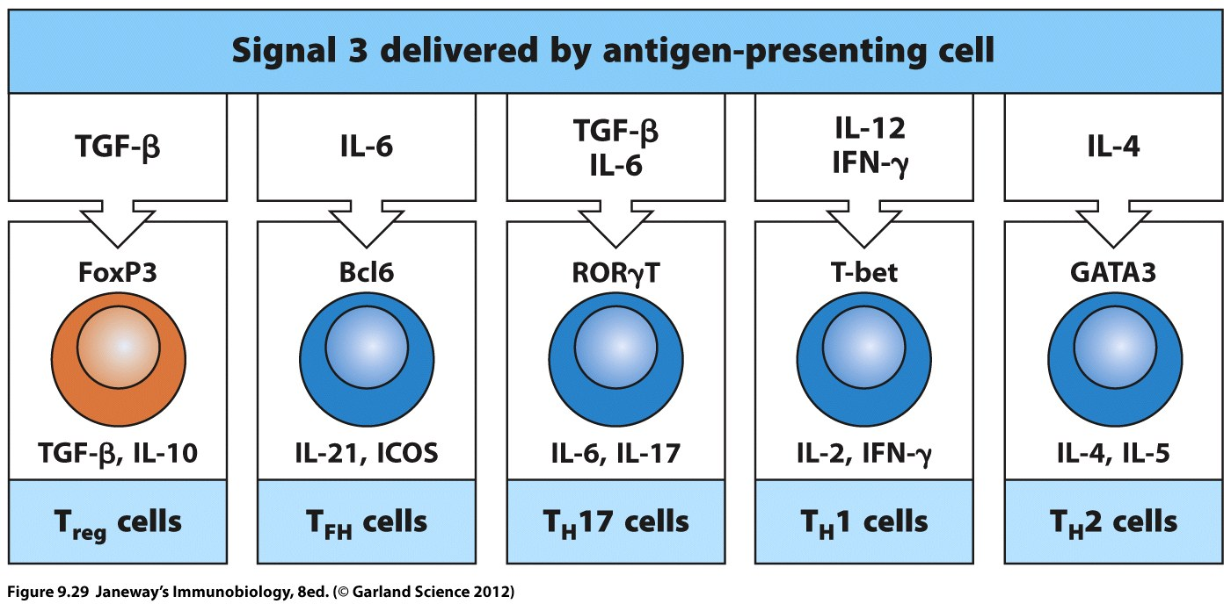
Transcriptional Factors
Department of Biochemistry and Biotechnology
Innate Immunity-Antigen Processing and Presentation

Slide 68
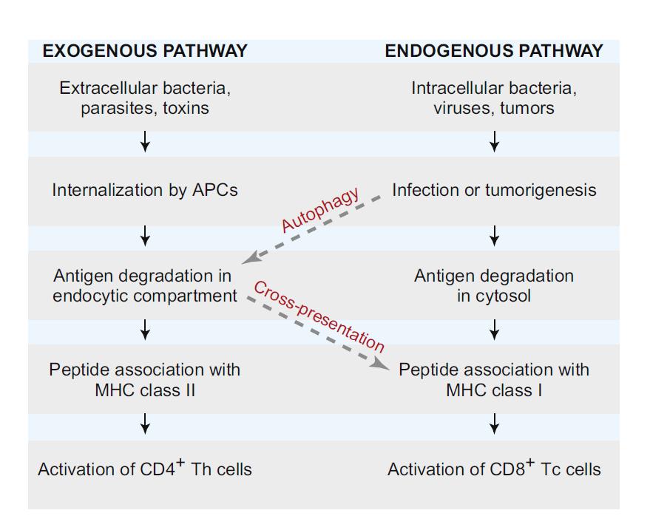
Department of Biochemistry and Biotechnology
Innate Immunity-Antigen Processing and Presentation

